Slide 1
An Efficient IDS Framework for DDoS Attacks in SDN Environment May 2021 IEEE Access 8 citations
Rohullah Jahanafrooz
1401/10/13

Slide 2
Problem
SDN:
Benefits: control, program, scalability, adaptive, dynamic
defects: centralized, dummy switches
Challenges: heavy traffic flow in network monitoring and attack detection
Goal: fast DDoS detection

Slide 3
D3 in brief
DPDK based DDoS detection implemented as NFV (no hardware-dependent)
An lightweight statistical anomaly algorithm that is based on a single parameter implemented some parts of it in Data-Plane.

Slide 4
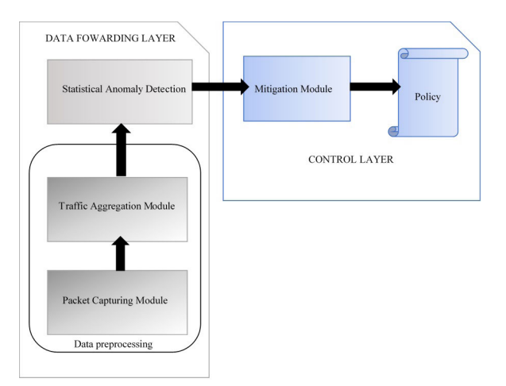
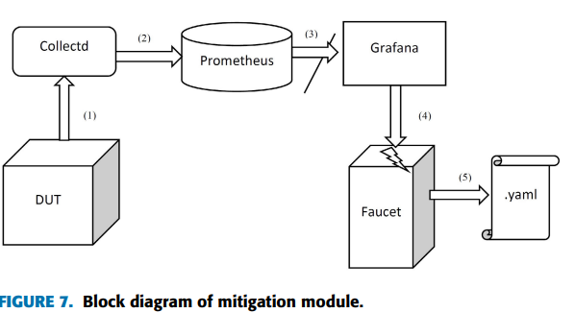
Architecture
Modules

Slide 5
Evaluation
It is better in throughput, packet drop rate in opposing to OVS and different IDSs.
because of using DPDK, it is better than SDN-based approach in detection time, memory usage, precision, F1, alpha error using CIC DOS dataset
OVS-daemon
OVS DB
PacketGen
OVS-daemon
host
AttackGen
DUT
D3
OVS-Controller
Faucet
Docker

Slide 6
Relation
Which component of our architecture? We can use DPDK for accelerating packet processing
Which problem it solve? High throughput capability
Why to use it?
Draw it in picture:

